Slide 1
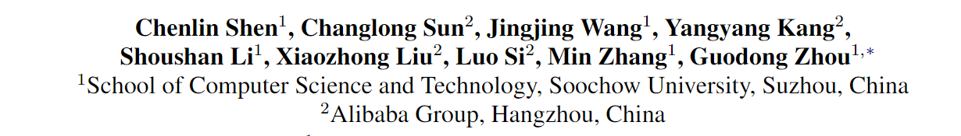
Sentiment Classification towards Question-Answering with Hierarchical Matching Network
方子玄
2019/4/16

Slide 2
Introduction
In an e-commerce environment, user-oriented question-answering (QA) text pair could carry rich sentiment information.
Sentiment analysis, a.k.a. opinion mining, is a task which aims to identify the user sentiment orientation of a product/brand/service by monitoring the online textual data, e.g., reviews and social media messages.

Slide 3
Motivation
Recently, a new QA-style reviewing form, namely “customer questions & answers”, has become increasingly popular on the giant e-commerce platforms.
However, because of the significant differences between QA-style and classical reviews, existing review mining algorithms, e.g., text-based sentiment analysis/classification, should not be directly applied to this new kind of QA-style data.
In this study, we propose a novel task/method to address QA sentiment analysis.

Slide 4
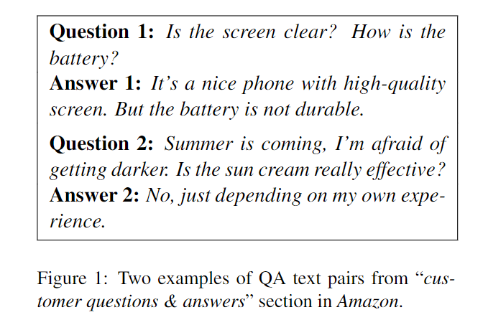
Challenges
First, in QA-style text, the question and answer text are more likely to be two parallel units rather than a sequence form.
Second, although the main sentiment polarity is usually expressed from the answer text, the question text could also carry important sentiment tips to predict the sentiment polarity of a QA text pair.
Third, in each QA text pair, the importance degrees of different [Q-sentence, A-sentence] units can be different.

Slide 5
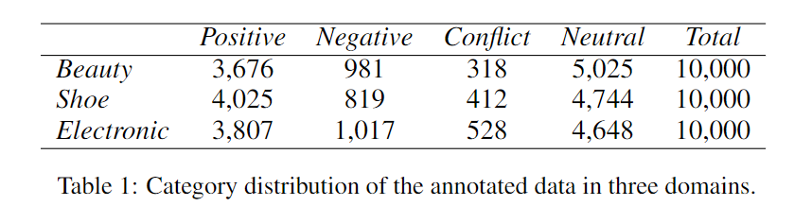
Data Collection and Annotation
We collect QA text pairs from “Asking All” in Taobao(Alibaba)

Slide 6
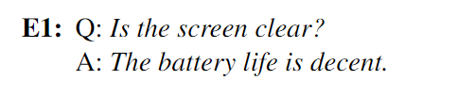

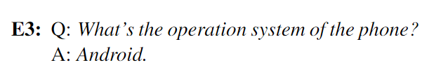
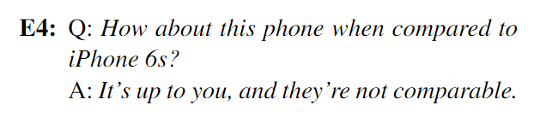
annotation guidelines
A QA text pair in which the question and the answer do not match is annotated as a neutral sample.
A QA text pair with an unknown or uncertain answer is annotated as a neutral sample.
A QA text pair with only objective description is annotated as an eutral sample.
A QA text pair which compares two different products is annotated as a neutral sample.

Slide 7
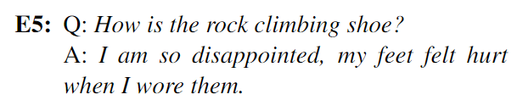

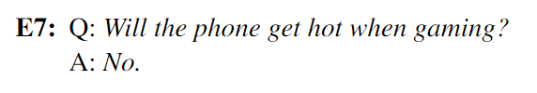

annotation guidelines
If the answer text contains sentimental expressions to question like “disappointed”, “terrible”, and so on.
If the answer text contains sentimental expressions to question like “perfect”, “satisfied”, and so on, we annotate it as positive.
If we cannot confirm the polarity of a QA text pair only depending on answer text, we annotate the polarity according to both the question and answer text.

Slide 8
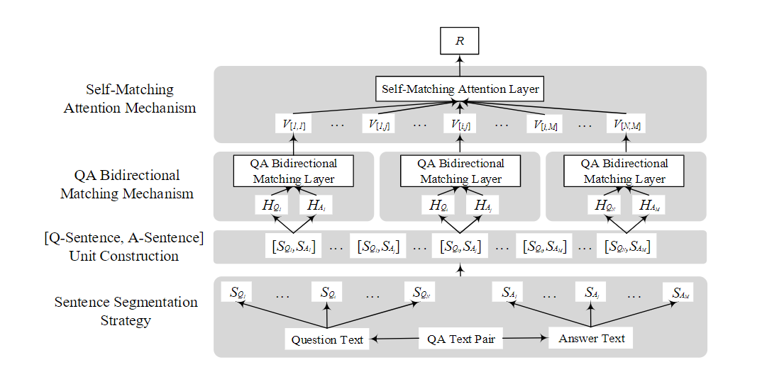
Methodology

Slide 9
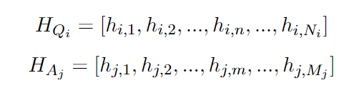
Word Encoding Layer
After sentence segmentation, the question text in a QA text pair contains N sentences, SQi represents the i-th sentence in the question text. Similarly, the answer text in this QA text pair contains M sentences, SAj represents the j-th sentence in the answer text.
Given a [SQi, SAj] unit in this QA text pair, we first convert the words to their respective word embeddings.
We then use Bi-directional LSTM (namely Bi-LSTM), which can efficiently make use of past features (via forward states) and future features (via backward states) for a specific time step, to get contextual representations of SQi and SAj individually.

Slide 10
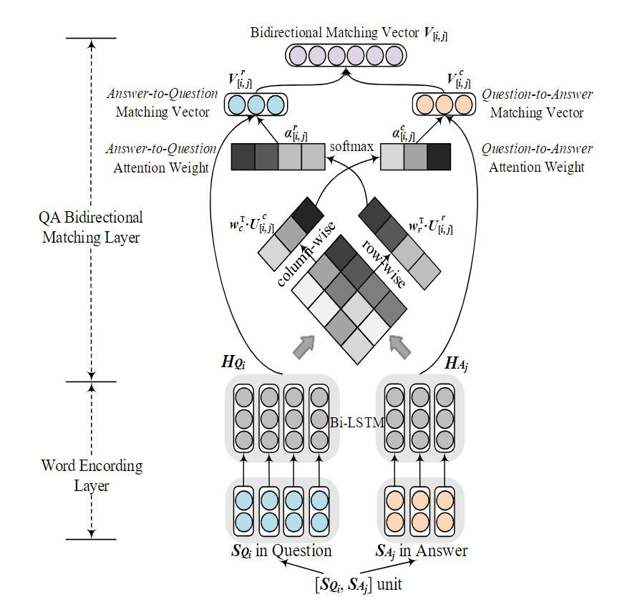

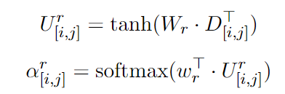

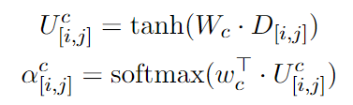


QA Bidirectional Matching Layer
Answer-to-Question Attention:
Question-to-Answer Attention:

Slide 11
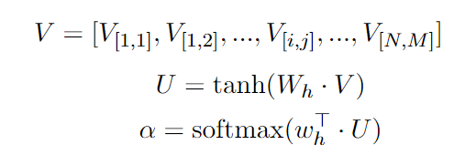

Self-Matching Attention Mechanism
Intuitively, each matching vector for [Q-sentence, A-sentence] unit holds different importance to a QA text pair.
To better aggregate the evidence from these vectors for inferring the sentiment polarity of the QA text pair, we propose a self-matching attention layer, matching these informative vectors against themselves.

Slide 12

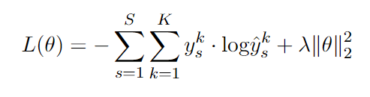
Classification Model

Slide 13
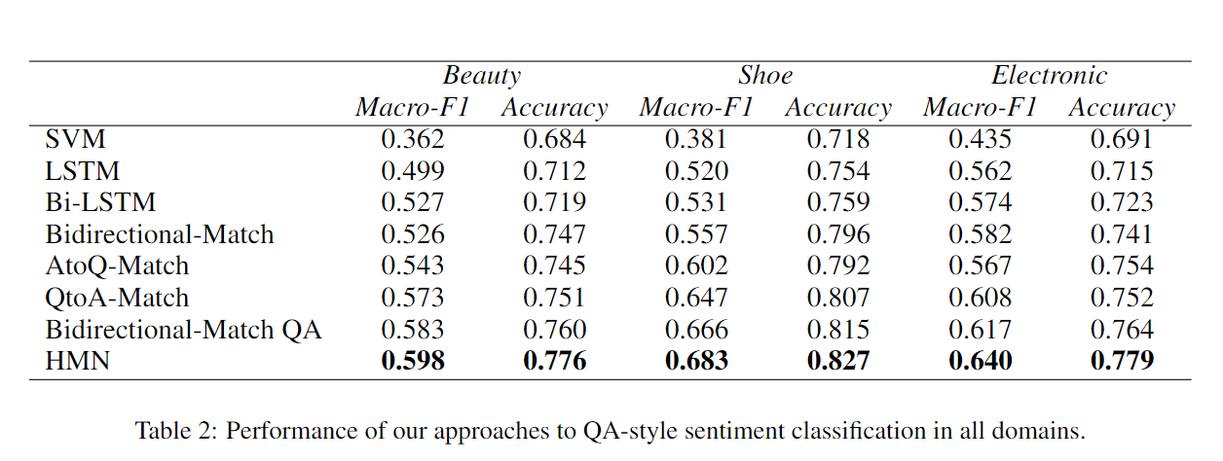
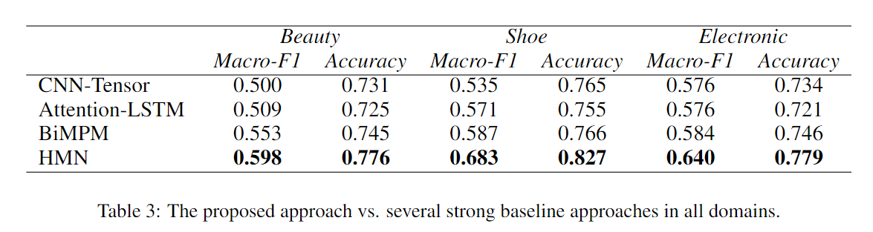
results

Slide 14
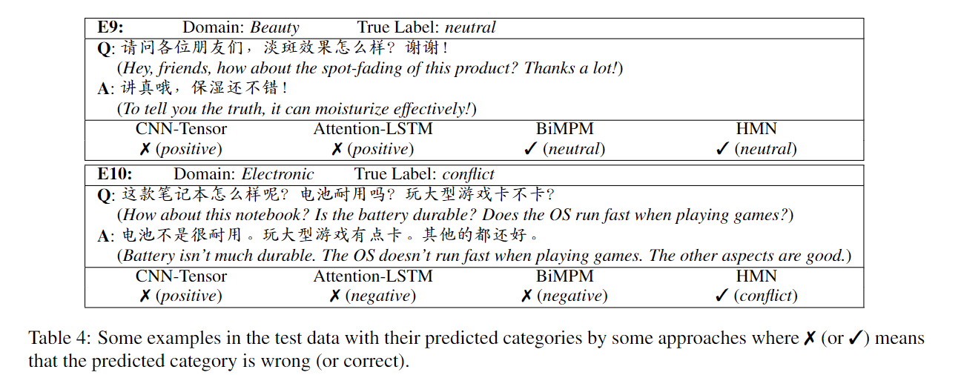

Slide 15
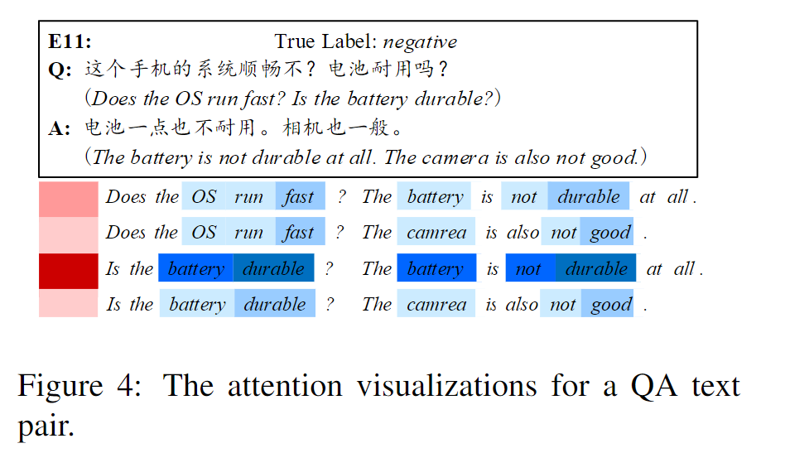

Slide 16
Thanks!

